Slide 1
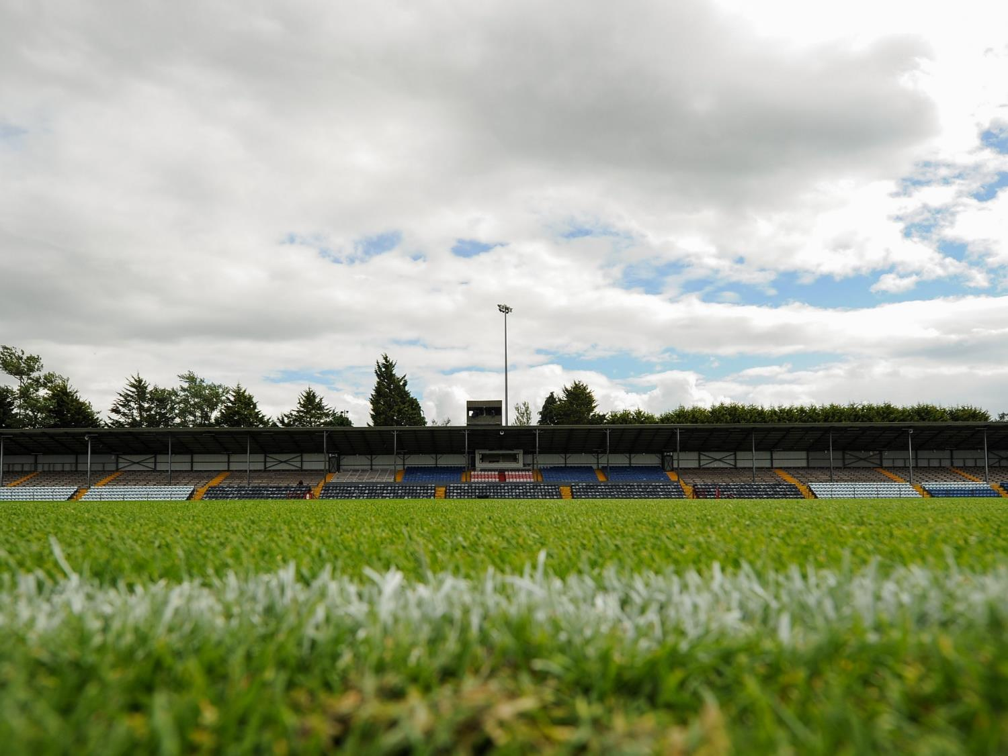
CLUB PLANNING
A Facilitator’s Viewpoint

Slide 2
Club Plan
Where are we?
How will we get there?
Where do we want to go?
How will we measure progress?
Notes:
Pre-Workshop Actions
Update Club Name
Notes
Introduction - Club Chairperson
Brief outline of why the Club is putting a Plan in place - to outline the objectives for the Club over the next 3 years
Define what the Plan will be for the Club:
To be developed by the Club and for the Club
To be reviewed on an ongoing basis
It will be a practical document direct the Clubs work

Slide 3
The Club Planning Process
Getting Started
Expression of Interest
Doing the Groundwork
Completing Groundwork Actions
Planning Team Meeting
Crafting the Strategy
Club Planning Workshop
Ongoing Consultation
Writing the Plan
Achieving Results
Drafting the Club Plan
Implementation
Introductory Contact
Launching the Club Plan
Mid-point Review
Full-term Review
Coordinator Appointed
Notes:
Notes
The Club Planning Process - Club Plan Facilitator
Run through of the 12 steps across five phases that should be completed in developing a three-year Club Development Plan
Highlight that while there is still significant work to be done, the Club has already completed a lot of work to get to the Club Planning Workshop which is the mid-point in the process.
Emphasise that once the Plan is launch, the “real” work begins when the Plan is being implemented – this is the only way to make the process a success.

Slide 4
Survey – Preliminary Findings

Slide 5
Is the club still relevant?
100%

Slide 6
The Club Planning Process
Getting Started
Expression of Interest
Doing the Groundwork
Completing Groundwork Actions
Planning Team Meeting
Crafting the Strategy
Club Planning Workshop
Ongoing Consultation
Writing the Plan
Achieving Results
Drafting the Club Plan
Implementation
Introductory Contact
Launching the Club Plan
Mid-point Review
Full-term Review
Coordinator Appointed
Notes:
Notes
The Club Planning Process - Club Plan Facilitator
Run through of the 12 steps across five phases that should be completed in developing a three-year Club Development Plan
Highlight that while there is still significant work to be done, the Club has already completed a lot of work to get to the Club Planning Workshop which is the mid-point in the process.
Emphasise that once the Plan is launch, the “real” work begins when the Plan is being implemented – this is the only way to make the process a success.

Slide 7
Six Discussion Areas
Odd Numbers
Even Numbers
Workshop 1
Adult Games Development & Player Welfare
Juvenile Games Development
Workshop 2
Club Structures & Administration
Finance & Fundraising
Workshop 3
Facilities & Development
Communications, PR & Culture
Notes:
Notes
Discussion Areas – Club Planning Facilitator
The main part of the Workshop is the 3 discussions within it.
The topics of these workshops are based on the Five Foundations of a Well-Run Club, listed on the screen at the start of the slide*
Coaching & Games is split into two – adult and juvenile – due to its importance and the variance between the age groups
Facilitate the discussion throughout the next 60 – 90 minutes:
Early in each discussion workshop, pause it to get some early feedback from one or two tables – this will focus the mind and makes sure everyone is on the right track
Explain that all their suggestions will be collected at the end of the night but at the end of each discussion, they will be asked to share either:
A maximum of three things to continue doing
A maximum of three things to start doing
The one thing to stop doing
Go to a different table / group for each of the above
Explain that if anyone has anything they would like to suggest to the Club Plan Steering Committee and they don’t get a chance on the night due to looking at a different topic / not thinking of it in time etc., they can note it in the relevant section of the Feedback Booklet
* There is one simple animation on this slide moving from the Five Foundations of a Well-Run Club to then visually represent the three discussion workshops as well as allocating topics to tables

Slide 8
Setting up and Managing
Focus Groups
Club sought volunteers for the five focus groups at well attended workshop
Focus Group leaders appointed by Club Plan Steering Committee
Each group met 2-3 times over six weeks with the feed-forward workshop with facilitator, committee and focus group leaders
Recommendations from groups presented to the Club Plan Steering Committee for final consideration
Plan compiled and published November 2018

Slide 9
The Club Planning Process
Getting Started
Expression of Interest
Doing the Groundwork
Completing Groundwork Actions
Planning Team Meeting
Crafting the Strategy
Club Planning Workshop
Ongoing Consultation
Writing the Plan
Achieving Results
Drafting the Club Plan
Implementation
Introductory Contact
Launching the Club Plan
Mid-point Review
Full-term Review
Coordinator Appointed

Slide 10
The Club Planning Process
Role of facilitator
Role of Committee(s) and Club Plan Coordinator
Pre-planning and the power of data
Link to County and County Development Officer
Link to Club Leadership and Development Programme
Buy-in is everything- inherently part of recruiting more volunteers
A living and changing plan- publishing of plan is just the end of the beginning

Slide 11
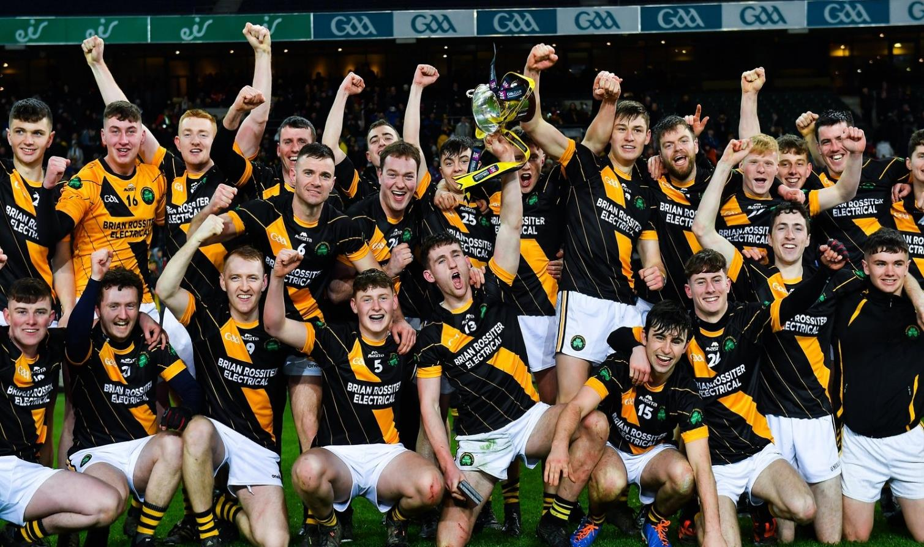

Slide 12
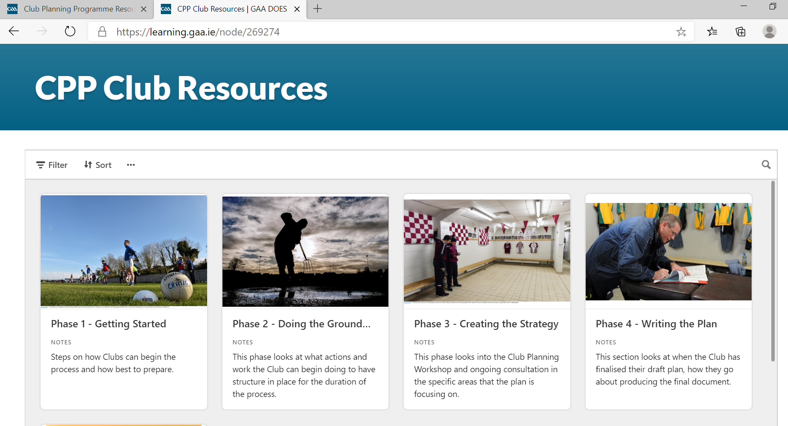

Slide 13
Go Raibh Maith Agaibh

