Slide 2
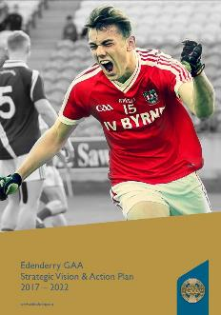
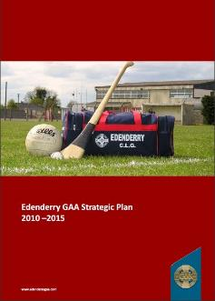
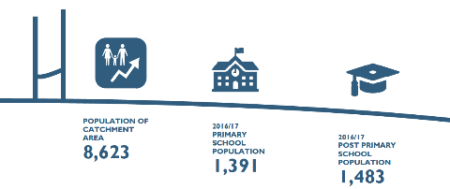
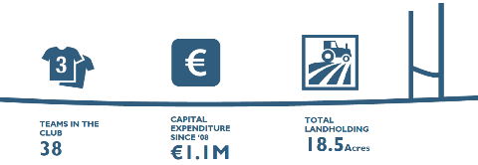
Responding to Change
…Planning ahead helps us to meet current demand and ensure we are prepared for future challenges…
Total Expenditure since ‘08
€2.4M
40+

Slide 3
Why Did We Begin Planning?
Poor record in…
Governance
Discipline
Bord na nÓg Committee
Ladies Football Club
CONFLICT
Perceived as…
Unsuccessful
Disorganised
Unresponsive
Closed Shop
Elitist
Not Relevant
Deficit in…
Unity of Purpose
Communications
Quality Atmosphere
Playing Facilities
Finance
Player Development
Player Retention
Executive Committee
Pre 2009 Structure Prevented Club Realising its Full Potential

Slide 4
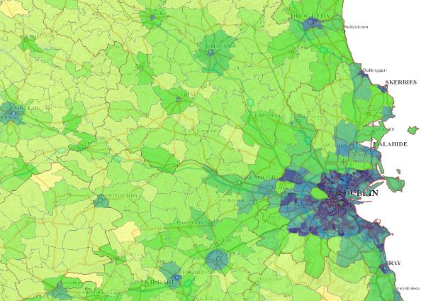
Changing Community
+ 80%
Meath
Westmeath
EDENDERRY
Kildare
80% of Pop. located within Urban Area
Proximity & Accessibility to the GDA led to Pop. Growth

Slide 5
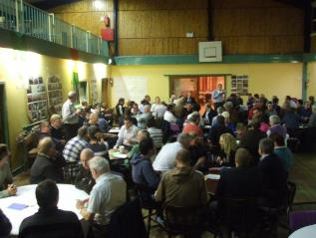
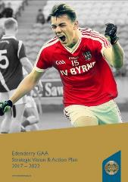
Methodology
600 + Hours of Voluntary labour
2.
Workshop
3.
Focus Groups
Club Executive
Offaly Co. Board
Leinster Co.
Croke Park
Players
Parents
Members
Coaches
Teachers
Sponsors
Supporters
1.
Steering
Committee
4.
Focus Group
Review
Outputs
6.
Implementation
&
On-going
Review
5.
Plan
Launch
Over 110 at Open Workshop & 50 Volunteered for Focus Groups

Slide 6
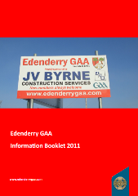
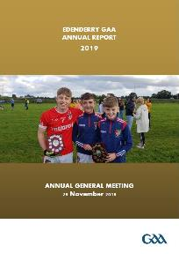
Club Structure & Administration
Executive
Committee
Club Trustees
Bord na nÓg
Sub-Committee
Facilities Development
Sub-Committee
Finance
&
Fundraising
Sub-Committee
Coaching
Co-ordinator
Child Welfare Officers
Membership
Disciplinary Committee
Team Appointments Committee
Communications PR &
Social/Cultural
Sub-Committee
Coaching & Games Development
Sub-Committee
Ladies Football Committee
Code of Conduct
&
Administration Guide
Increased Involvement with Maximised Effectiveness & Efficiency

Slide 7
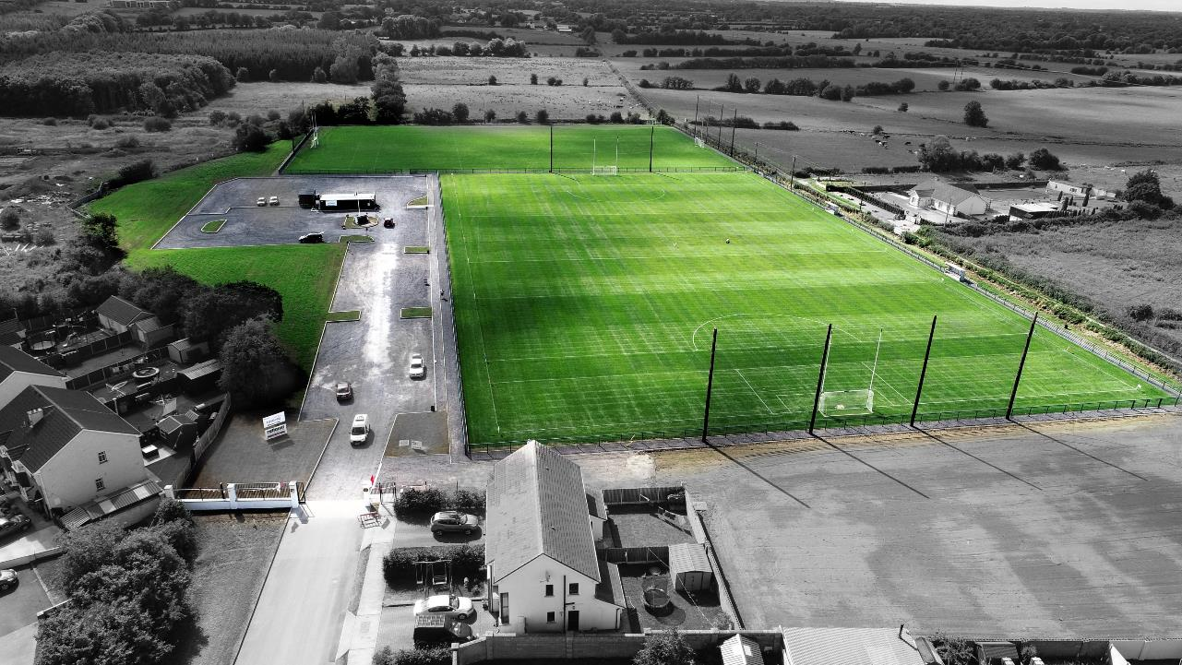
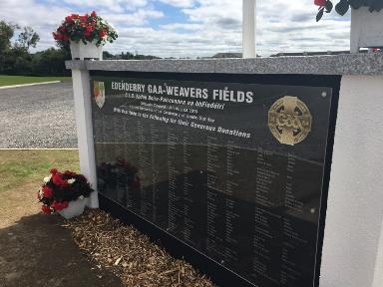
Key Benefits
Membership & Participation Expanded
One Club Model / GPO / All Codes
Community Backing
Major upgrade to facilities / Club 300 Membership
Succession Planning
Administration Structures / Development of New Officers
The people who are Edenderry GAA Club developed this Strategic Plan

Slide 8
www.edenderrygaa.ie

